Slide 1
Web Observatory: Components of an Application

Slide 2
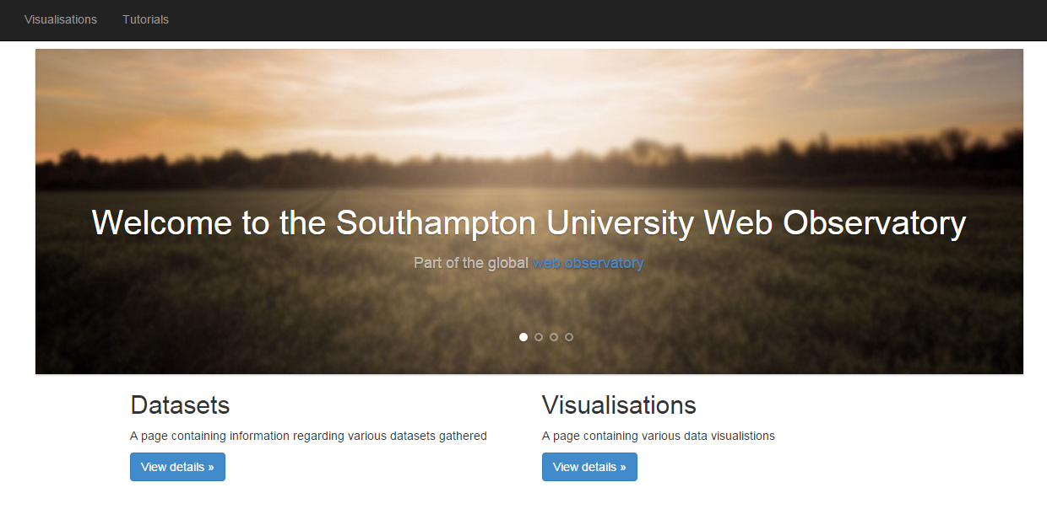
Web Observatory Architecture…
External APIs
Twitter
Wikipedia
Instagram
Google Trends
Yahoo Trends
Soton Web Observatory
HTTP Streaming Stage:
1. Send Stream to Web Observatory Server
Unstructured Web Streams or Web Scraped Pages
Web Observatory API (REST/ Socket.IO)
Pre-processing Stage:
1.Enrich Streams 2. Unify feeds into WO JSON Format
Streaming Stage:
1. Post incoming stream to RabbitMQ exchange (each source has its own exchange)
RabbitMQ JSON Stream
Web Observatory Socket
Hadoop Storage Stage:
1. Apache Flume for each stream
Daily Storage Stage:
1. MapReduce Daily Results
Web Observatory JSON Data Schema
MongoDB
HDFS
2

Slide 3




Making an App – What you Need
Backend
Node.JS
RabbitMQ/AMQP
Socket.IO
Front End
Socket.IO
D3.j3 (Or other Javascript Vis library)

Slide 4
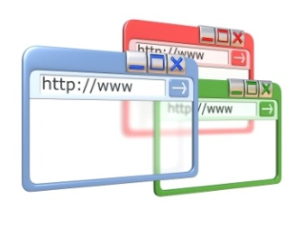


The components of an App*
*This is only one way of doing it – experiment to find others!
External APIs
(Some streaming/RESTFUL Web API
Node.JS Server
Connect to the External Service via their API or RabbitMQ AMQP Exchange
Process the stream to your requirements
Create a Socket.IO connection
Start Web server, emit the data!
HTML Front End
Connect to the Socket.IO and start receiving the data! (onLoad() method, perhaps)
Process the data ready into the suitable representation for a visualisation or JavaScript Components
3. Update the front end when new data comes (if using a framework this can help)
JSON (usually) Web Streams
AMQP Message package
Message via socket.io
RabbitMQ Exchange
AMQP Exchange or Channel
*This is only one way of doing it – experiment to find others!

Slide 5
An Example – Twitter Stream, Node.JS and Socket.IO
Fork from:
https://github.com/raminetinati/TwitterNodeSocketExample.git
Provides simple template of how to use:
Twitter API (and Web Observatory API)
http
Node.JS
Socket.IO

Slide 6
Step One – Create the Backend
Create the HTTP Server and Socket:
var app = require('http').createServer(handler);
var io = require('socket.io')(app);
Create the Twitter Connection and setup the stream
var Twit = require('twit')
var T = new Twit({
consumer_key: 'REQUIRED'
, consumer_secret: 'REQUIRED'
, access_token: 'REQUIRED'
, access_token_secret: 'REQUIRED'
});
var stream = T.stream('statuses/sample');

Slide 7
Step Two – Start Sending the Data
Start the Stream and emit to the socket
stream.on('tweet', function (tweet) {
console.log(tweet);
io.emit('tweets',tweet);
});
Now We’re ready to receive it on the front end….

Slide 8
Step Three - Receiving the Data on the Client
Receive the data from the socket
var socket = io.connect(‘serverAddress');
socket.on('tweets', function (tweet) {
var image_url = "";
if(tweet.entities.media[0]){
var url = tweet.entities.media[0];
url = url.media_url;
image_url = url;
}
// Here we can get some of the images in the Tweets
if (image_url && image_url != "") {
var div = $("#collageContainer");
var img = new Image(image_url);
img.onload = function () {
div.append($("<img src='"+image_url+"' height='100%'>"));
if (div.children().length > 25000) {
div.children()[0].remove();
}
};
}
});
};
//Connect to the Stream….
//Do some processing of the stream

Slide 9
Step Four – Show some data in the browser
Call the JavaScript method and add a div tag to an HTML Page
<body onload='main()'>
<div id="collageContainer" class="thumbimg"> </div>
</body>
And… You’re done☺

Slide 10
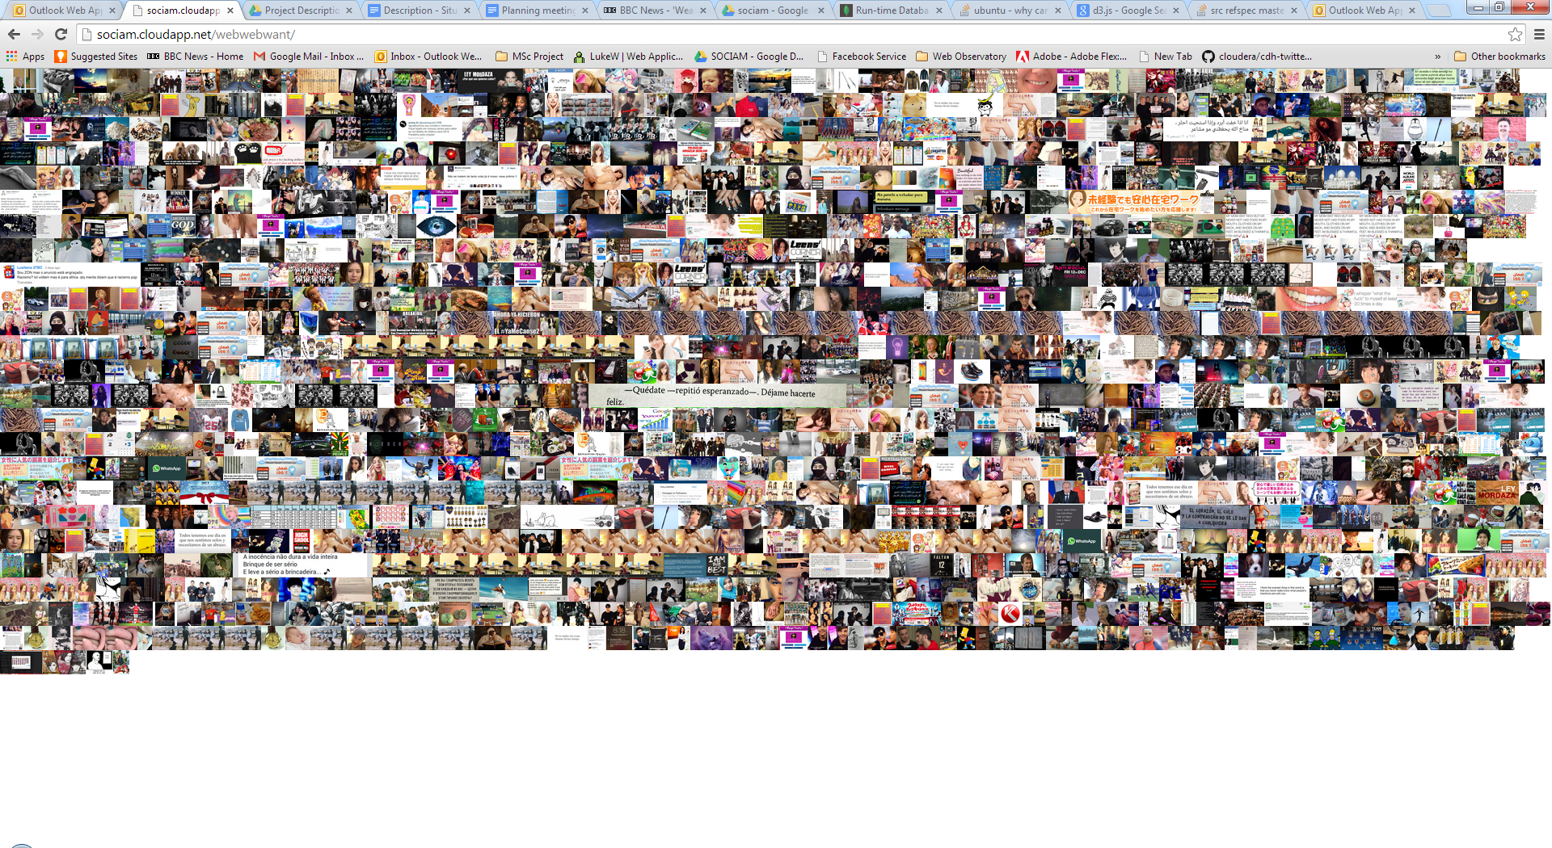
Step Five – Now Go Modify your Code!
This is just a Demo

